Slide 1
“Classification of yoga hand mudras using machine learining”

Slide 2
Presented By:
Anusha H M
II nd MCA
(P01ZZ22S126053)
DoS in Computer Science, MGM
Under the guidance of:
Meghana J H
Guest Faculty,
DoS in Computer Science, MGM

Slide 3
Contents:
Problem Statement
Introduction
Literature Survey
Dataset Collection
Proposed Methodology
Results
Conclusion and Future work
References

Slide 4
Problem Statement
The goal is to create a machine learning model that can accurately identify different yoga hand mudras in images.
Yoga hand mudras are specific hand gestures used in yoga, and correctly recognizing them is important for applications like digital yoga teaching and automated feedback.

Slide 5
Introduction
Yoga hand mudras are essential gestures used in yoga for meditation and healing. The goal is to develop a machine learning model that can accurately identify these mudras from images.
Mediapipe is used to extract feature(keypoints) from the hand and the extracted keypoints are divide into training and testing and given for Random Forest classifier .

Slide 6
Literature Survey
Paper | Dataset | Methods | Result
“Classification of Yoga Hand Mudras using SIFT and SURF” | Real-time data from the Centre for Yoga Studies at Annamalai University included 1,000 images of yoga hand mudras, with 100 images each for 10 different gestures: Brahma, Chin, Chinmaya, Linga, Prana, Prithvi, Rudra, Surya, Varun, and Yoni. The dataset was divided into 75% for training and 25% for testing. | Features are extracted using SIFT and SURF, where SIFT captures key points via DoG functions and SURF uses Haar wavelet responses. These are then classified using Gaussian Naive Bayes (GNB) for accurate handling of continuous data. | The system achieves a SIFT feature accuracy of 71.15% and a SURF feature accuracy of 45.51% for classifying yoga hand mudras.
“Natya Shastra: Deep Learning for Automatic Classification of Hand Mudra in Indian Classical Dance Videos” | The dataset includes 25 Bharatanatyam dance videos from YouTube, each up to 25 seconds long at 400x350 resolution, split into 150 frames with a 7:3 training-to-testing ratio. Despite challenges like lighting variations and incomplete hand portions, SIFT was used for keypoints extraction and a CNN-LSTM model integrated feature extraction and sequence prediction. | The method uses SIFT for robust keypoints extraction, handling variations in scale, rotation and lighting, with keypoints characterized by LoG. A CNN-LSTM model integrates CNN layers for feature extraction and LSTM layers for sequence prediction, leveraging pose-estimated keypoints for improved accuracy. | The proposed CNNLSTM achieved 93.4% accuracy, 93.3% precision, 97.2% recall, 98.2% AUC, and 97.24% F1-score, with a 97.24% accuracy at 65 epochs.
“Indian Classical Dance Mudra Classification Using HOG Features and SVM Classifier” | The dataset includes 120 dance mudra images from various sources, used to train a multi-class SVM classifier with dimensionality reduction and shape feature extraction, where ECOC achieved the best performance. | The experiment trains a multi-class SVM classifier on 24 Kuchipudi dance mudras, focusing on dimensionality reduction and shape feature extraction from binary images. Comparing SVM models like OVA, OVO, DAG, and ECOC, ECOC achieved the best performance, with evaluations using computer vision and machine learning techniques. | When classified using Multi-class SVM, HOG features achieved a higher Matching Rate Factor (MRF) of 98%, while MCW and SLIC features had an MRF of approximately 66%.

Slide 7
Literature Survey
Paper | Dataset | Methods | Result
“MediaPipe to Recognise the Hand Gestures” | American Sign Language consists of 266 different gestures that represents the English alphabet. | The system uses a 2-megapixel web camera to capture ASL gestures, preprocessing images by resizing, adjusting color and removing noise. Background subtraction isolates objects and contours are extracted for segmentation. An SVM classifier then compares processed images against an ASL database to accurately classify gestures. | Different numbers from 0 to 9 was recognised using the gestures. Have it was implemented using support vector machine algorithm. The model was tested and a trend for the accurate result.
“Applying Hand Gesture Recognition for User Guide Application Using MediaPipe” They recorded their own data for this study and created a small dataset. | They recorded their own data for this study and created a small dataset consisting of approximately 900 samples. This dataset includes 10 different varieties of hand gestures. | The methodology involves creating a user guide application with Kinect and MediaPipe to capture and recognize hand gestures. It processes real-time images to detect palms, generate 3D hand landmarks and identify finger states. Commands are executed based on predefined gesture conditions. | The results achieved a validation accuracy of 95% for recognizing hand gestures

Slide 8
Dataset Collection
Self-collected dataset using mobile camera with the distance of 1feet from hand to camera of 40 different people.
Total Images Collected: collected 40 images in each class.
Number of Classes: collected 6 different mudras.
Gyan mudra, Vayu mudra, Prithvi mudra, Surya mudra, Varuna mudra, Shunya mudra.

Slide 9
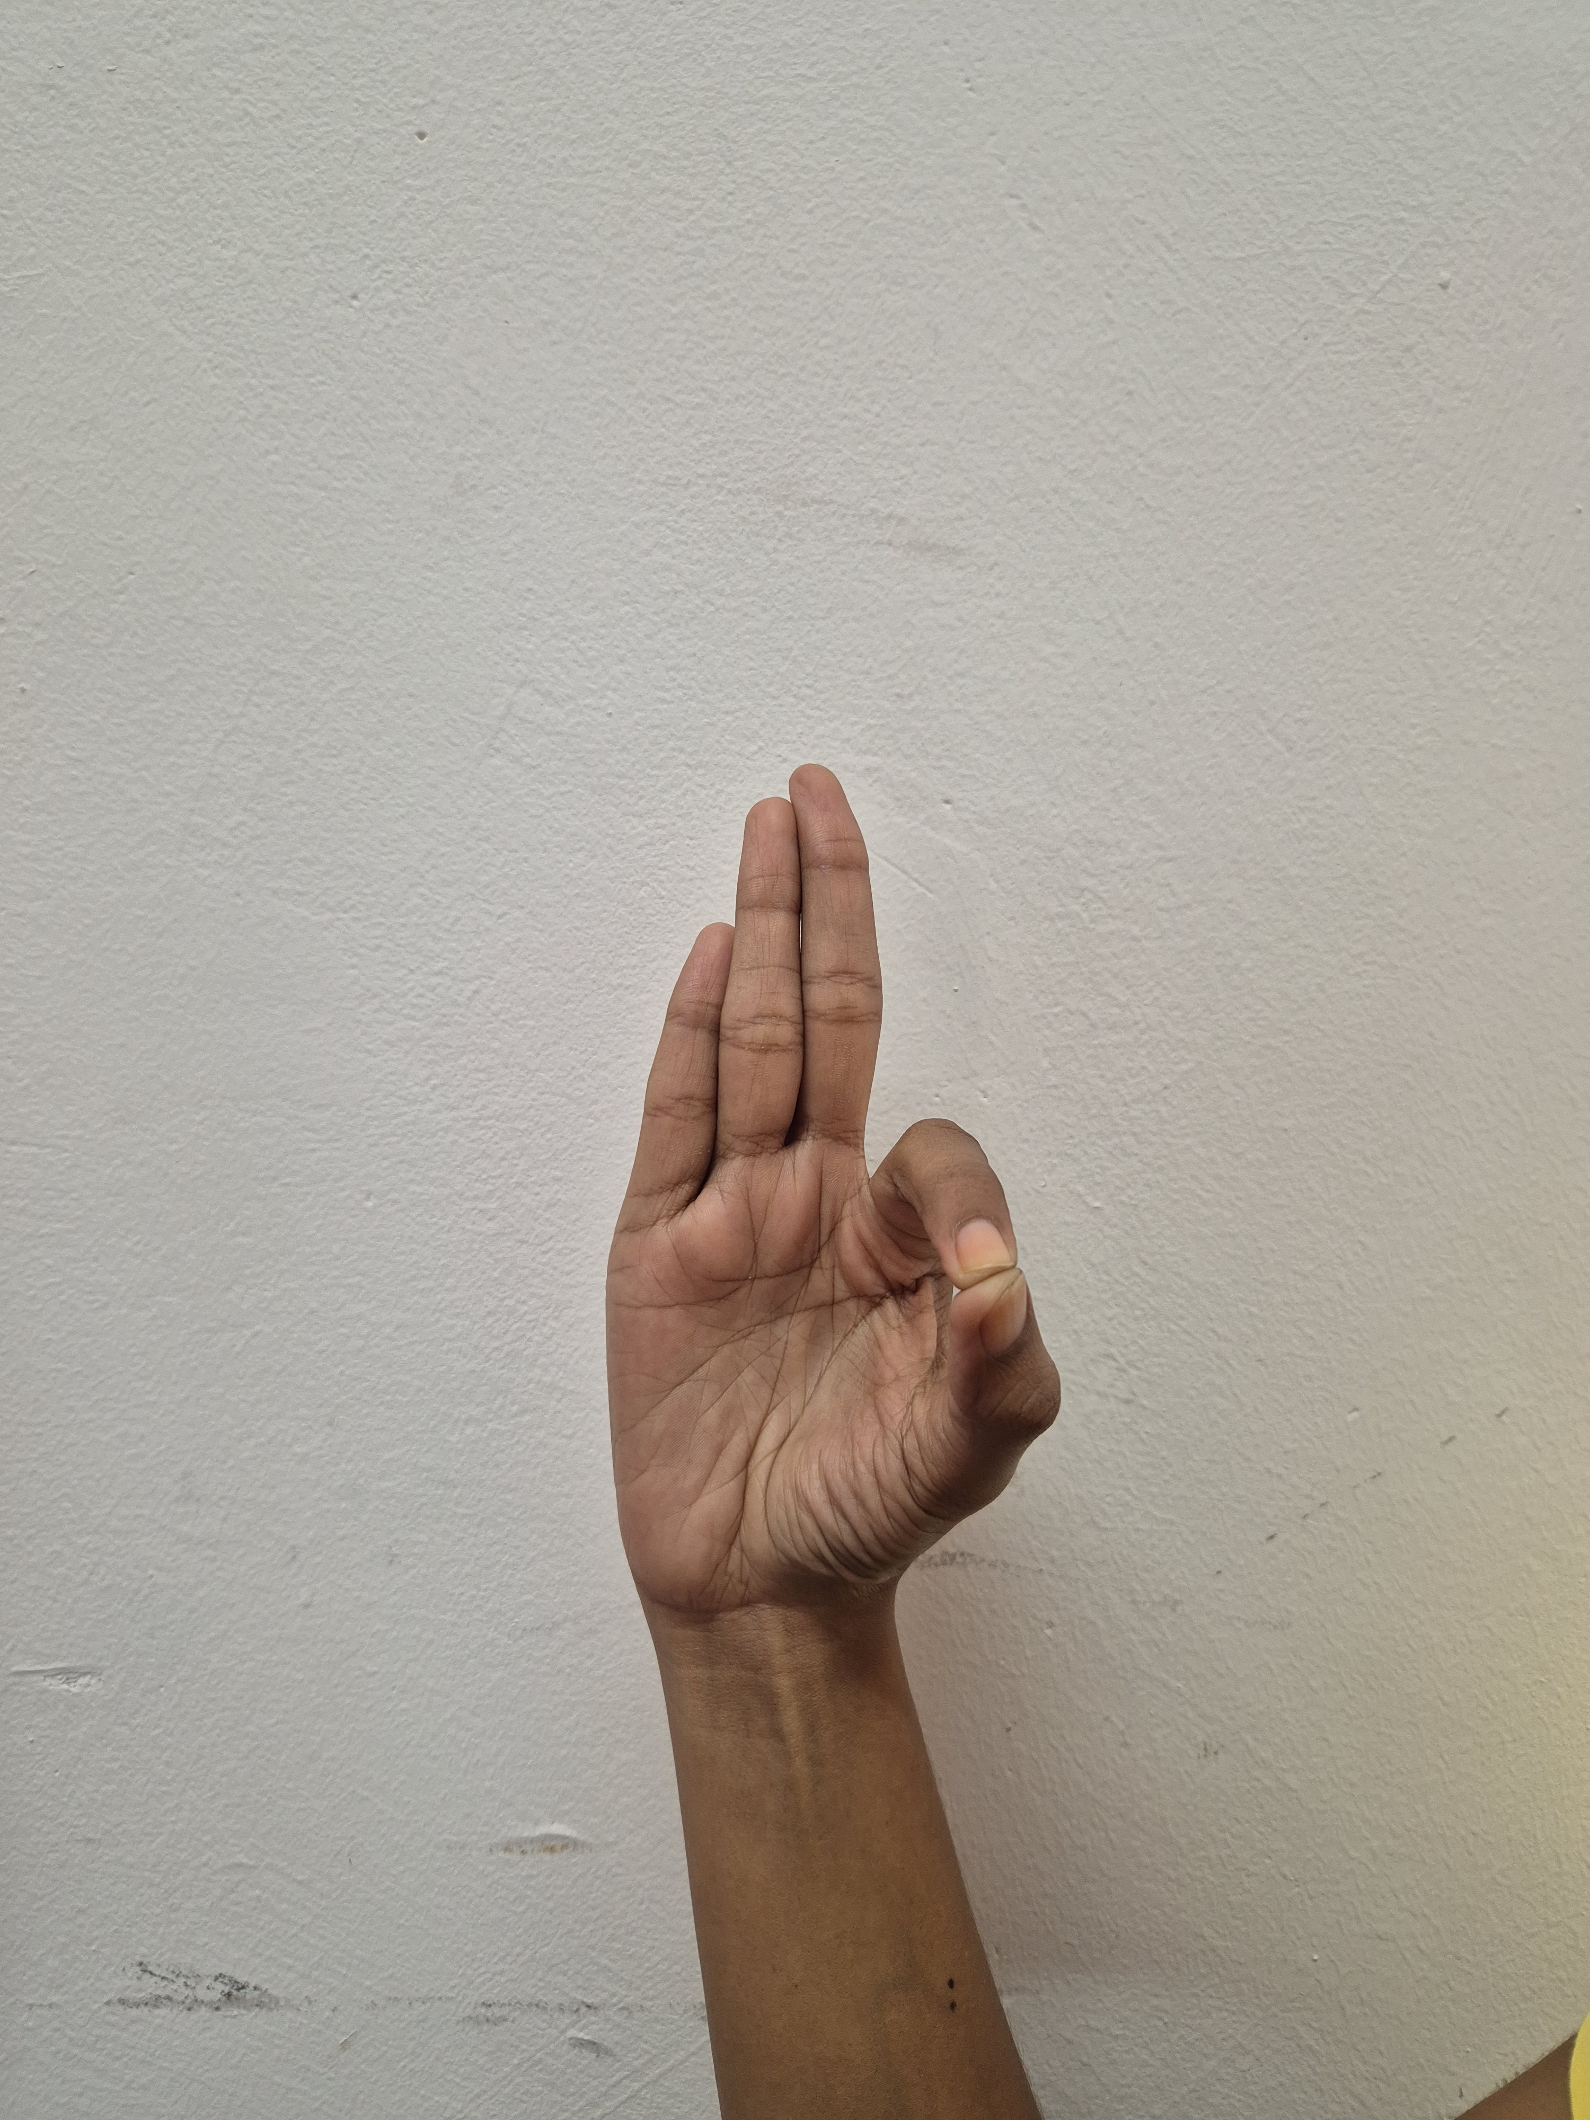
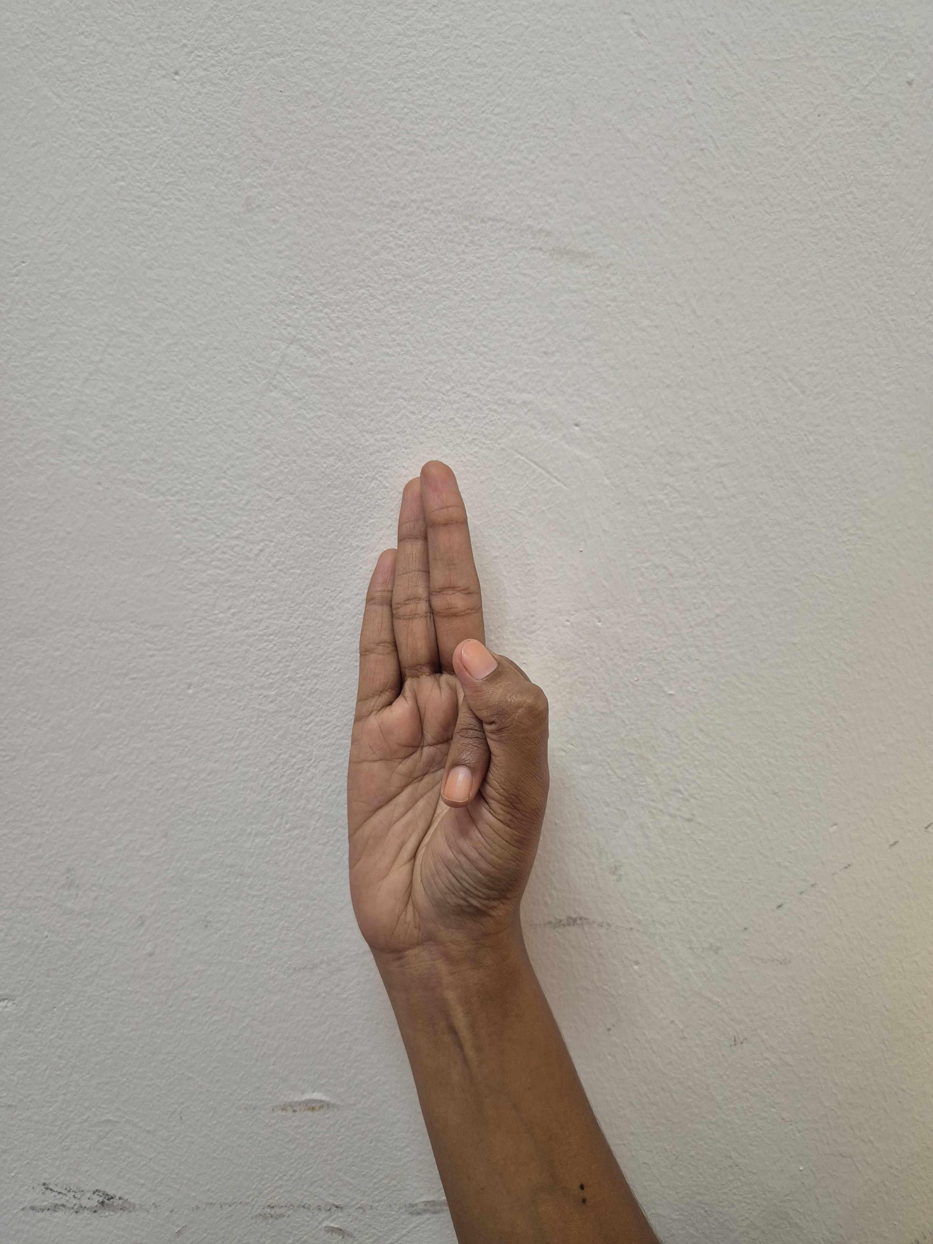
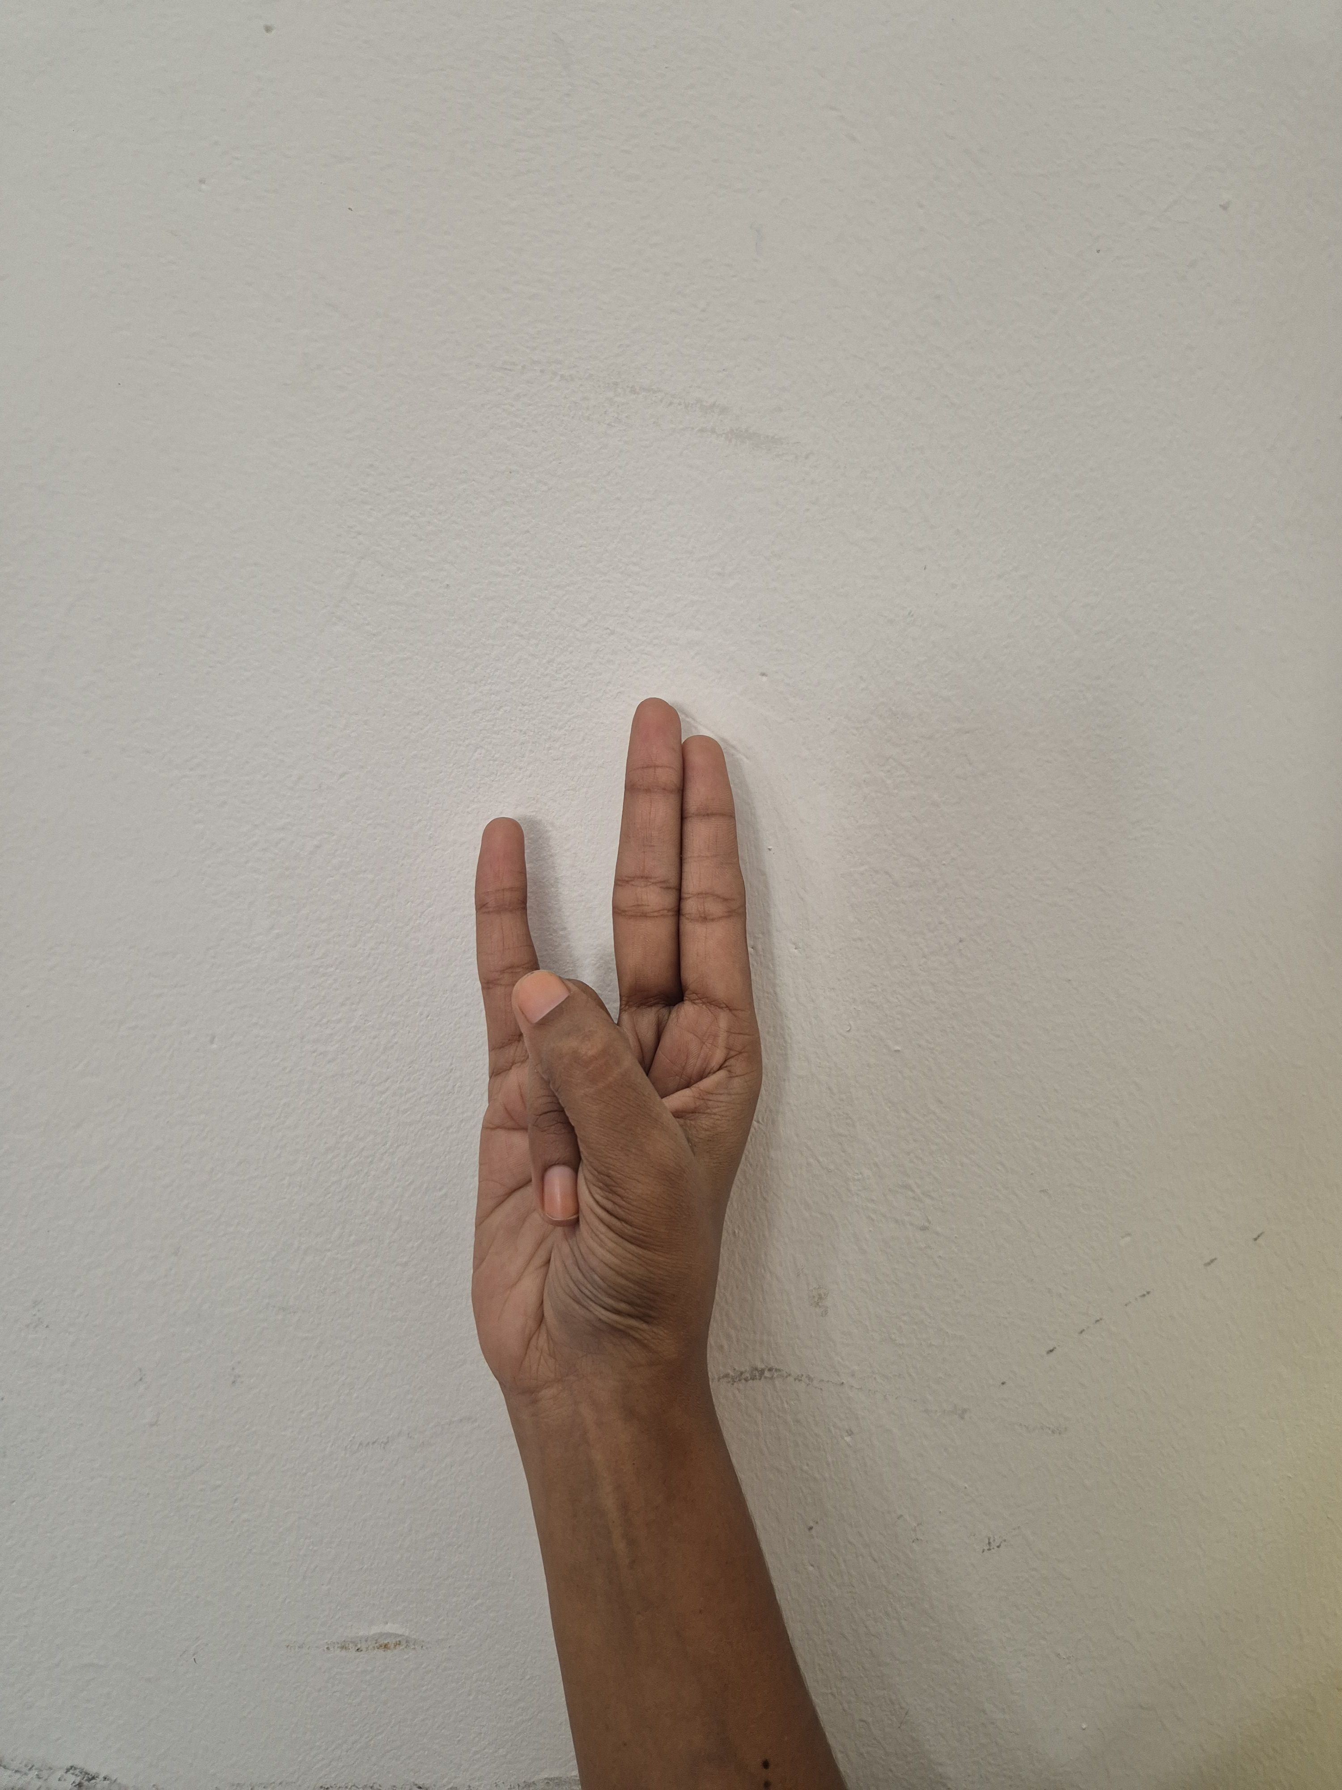
Dataset Collection
Gyan mudra
Vayu mudra
Surya mudra

Slide 10
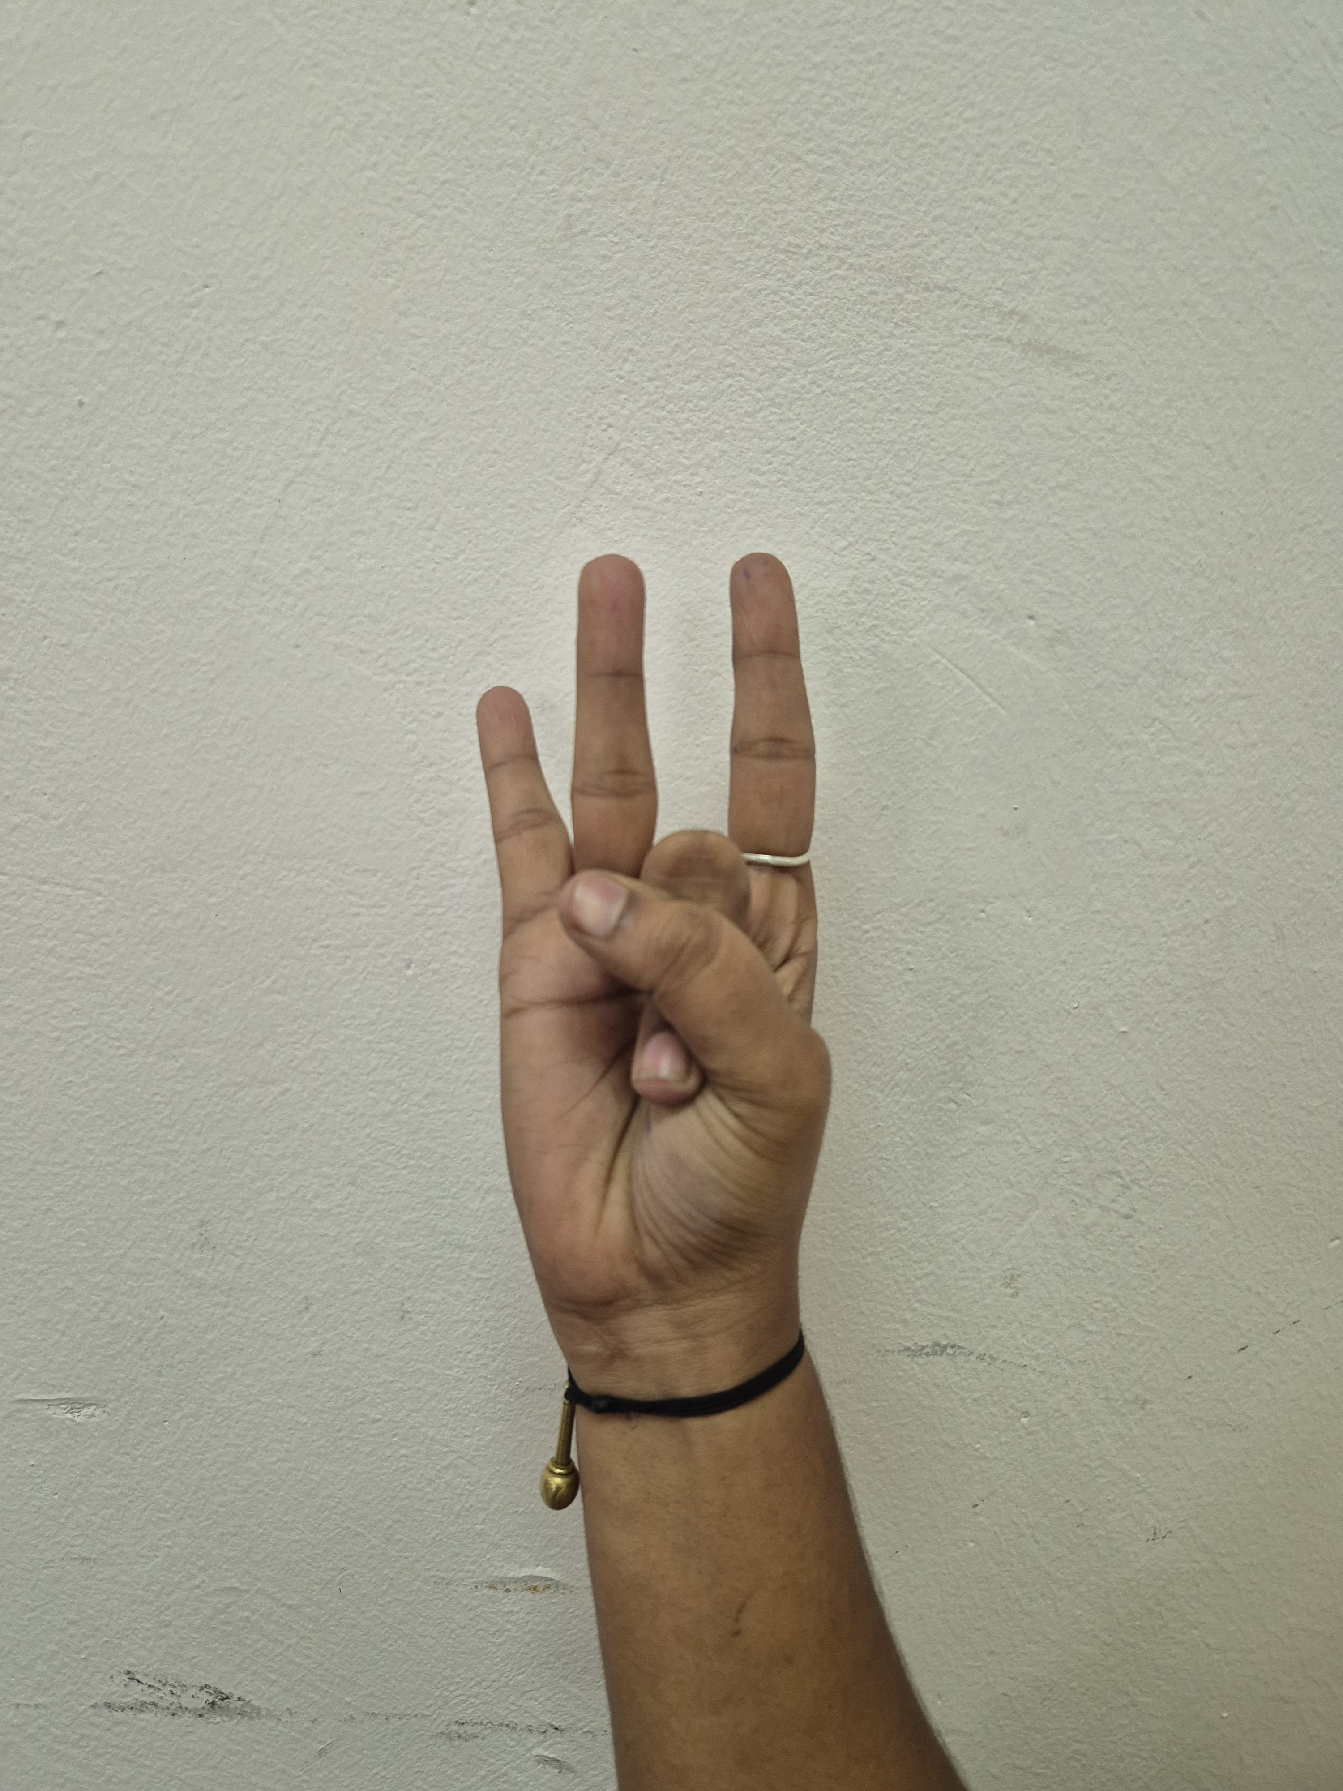
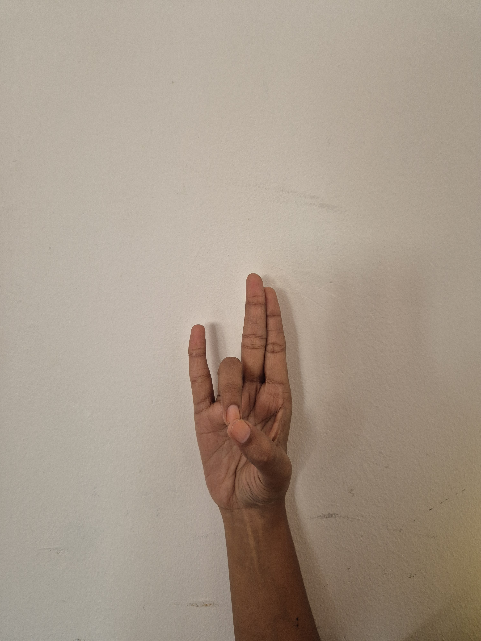
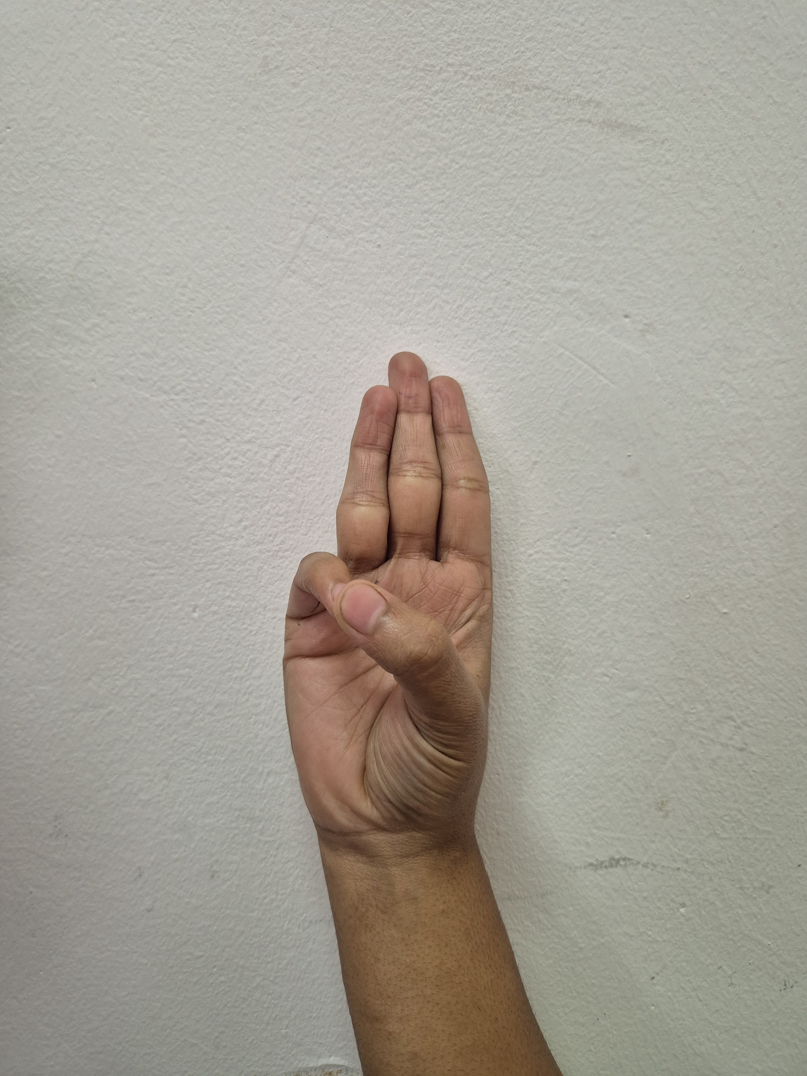
Dataset Collection
Shunya mudra
Prithvi mudra
Varuna mudra

Slide 11
Proposed Methodology
Dataset collection
Preprocessing
Feature Extraction (mediapipe)
Training
Testing
Classifier
(Random Forest)
Results

Slide 12
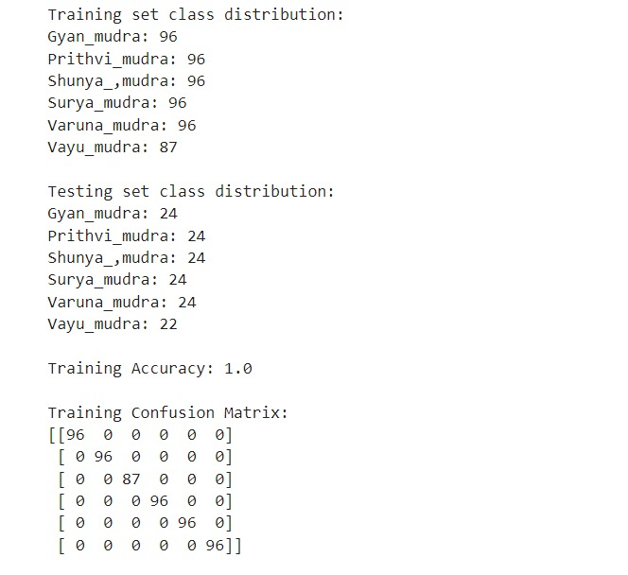
Results

Slide 13
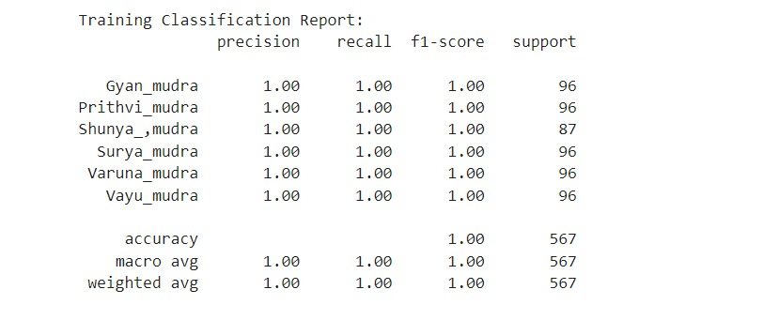
Results

Slide 14
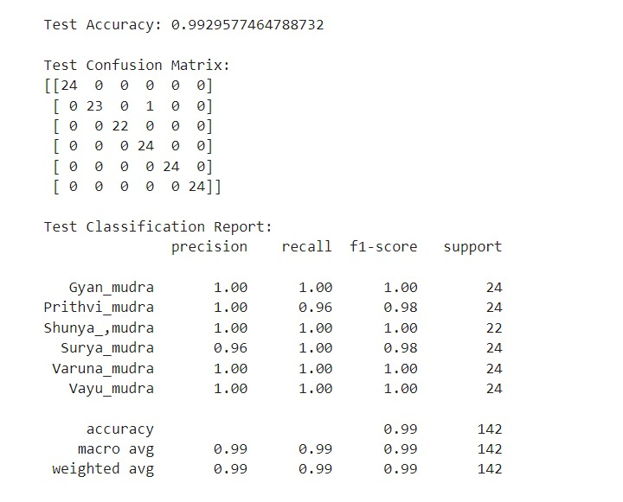
Results

Slide 15
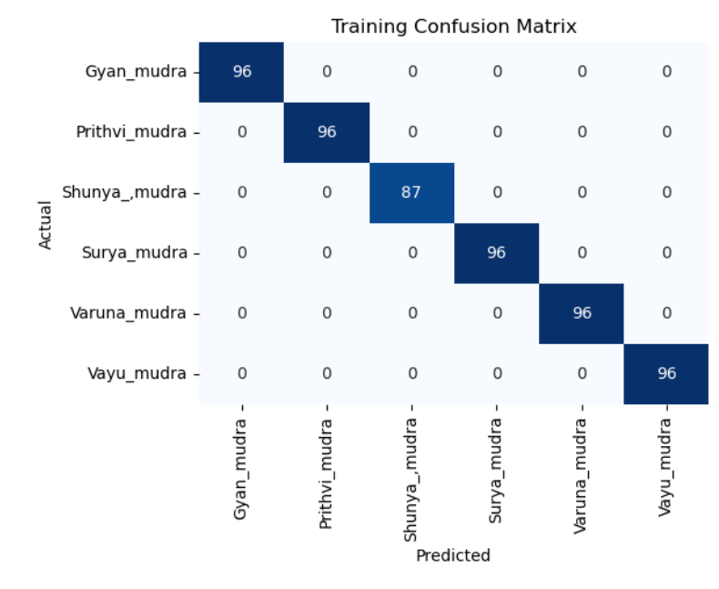
Results

Slide 16
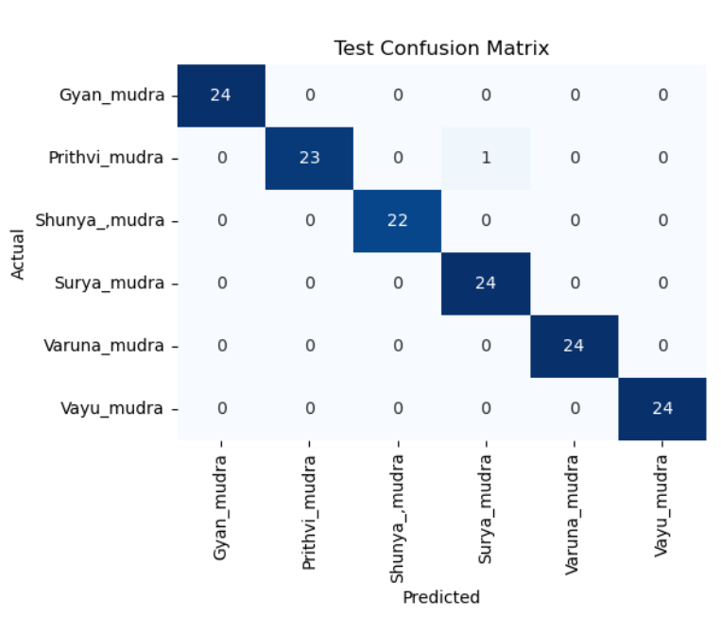
Results

Slide 17
Conclusion
In this project, we developed a machine learning model that accurately classifies yoga hand mudras using Mediapipe for hand landmark detection and a Random Forest classifier.
The model performed well across key metrics, proving effective in recognizing various mudras.
This system is a valuable tool for digital yoga instruction and cultural preservation, demonstrating how traditional practices can be enhanced through modern machine learning techniques.

Slide 18
Future Work
Expand Dataset: Collect more diverse data to improve model robustness.
Enhance Model: Explore CNNs for better accuracy in distinguishing mudras.
Implement Real-Time: Optimize for real-time feedback during yoga practice.
Add Features: Include a user friendly interface, voice guidance, and personalization.

Slide 19
Reference
S. Abarna1, V. Rathikarani2, P. Dhanalakshmi “Classification of Yoga Hand Mudras using SIFT and SURF Features ” International Research Journal of Engineering Science, Technology and Innovation Vol. 8(5) pp. 1-6, October, 2022 Available online http://www.interesjournals.org/IRJESTI
Pallavi Malavath, Nagaraju Devarakonda “Natya Shastra: Deep Learning for Automatic Classification of Hand Mudra in Indian Classical Dance Videos ” https://doi.org/10.18280/ria.370317
Indriani1 Moh.Harris1 Ali Suryaperdana Applying “Hand Gesture Recognition for User Guide Application Using MediaPipe” Department of Informatics Engineering, STMIK AMIKBANDUNG, Bandung, Indonesia.
LAVANYA VAISHNAVI D. A., ANIL KUMAR C., HARISH S., DIVYA M.Lb “MediaPipe to Recognise the Hand Gestures” WSEAS TRANSACTIONS on SIGNAL PROCESSING DOI: https://doi.org/10.37394/232014.2022.18.19
K.V.V. Kumar1 P.V.V. Kishore “IndianClassical Dance Mudra Classification Using HOG” Features and SVM Classifier International Journal of Electrical and Computer Engineering (IJECE) Vol. 7, No. 5, October 2017, pp. 2537~2546.

Slide 20
Thank You…

